Slide 1
Our Business Idea
Online T-shirt Selling From Branded Company Raw Material.
1

Slide 2




Key Partners
Your network of suppliers, partners, and strategic alliances
Focus on your business activities and outsource what partners can do.
Strategic partnerships
between competitors
To maintain the quality of the product, of course we need to deal with those company who deal with good fabric. Fabric is one of our key partners to run our business.
Joint Ventures to develop new businesses
Buyer-Supplier Alliances to assure reliable
supplies
Strategic alliances between non- competitors
it is important to have a logistics partner. It is not only for ship our products, it is also important for collect our resource
2

Slide 3
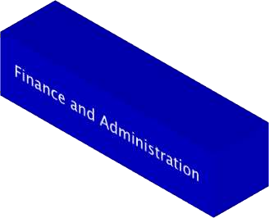
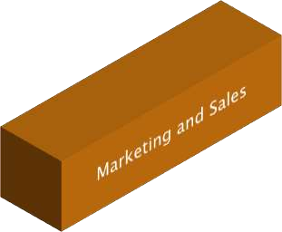

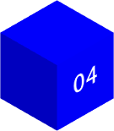
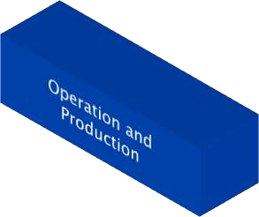

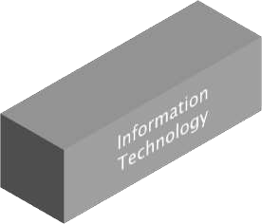


Key Activities
What are the actions the company do to operate successfully. It is closely related to Key partnerships
In order to perform the activities, you need the resources, partnerships, channels.
Need good fabric and machine to produce good quality
Marketing is where most of us shine. Marketing activities impact virtually every product or service
Supply chain management maintains the balance between the demand and supply and involves activities right from procurement of materials
3

Slide 4
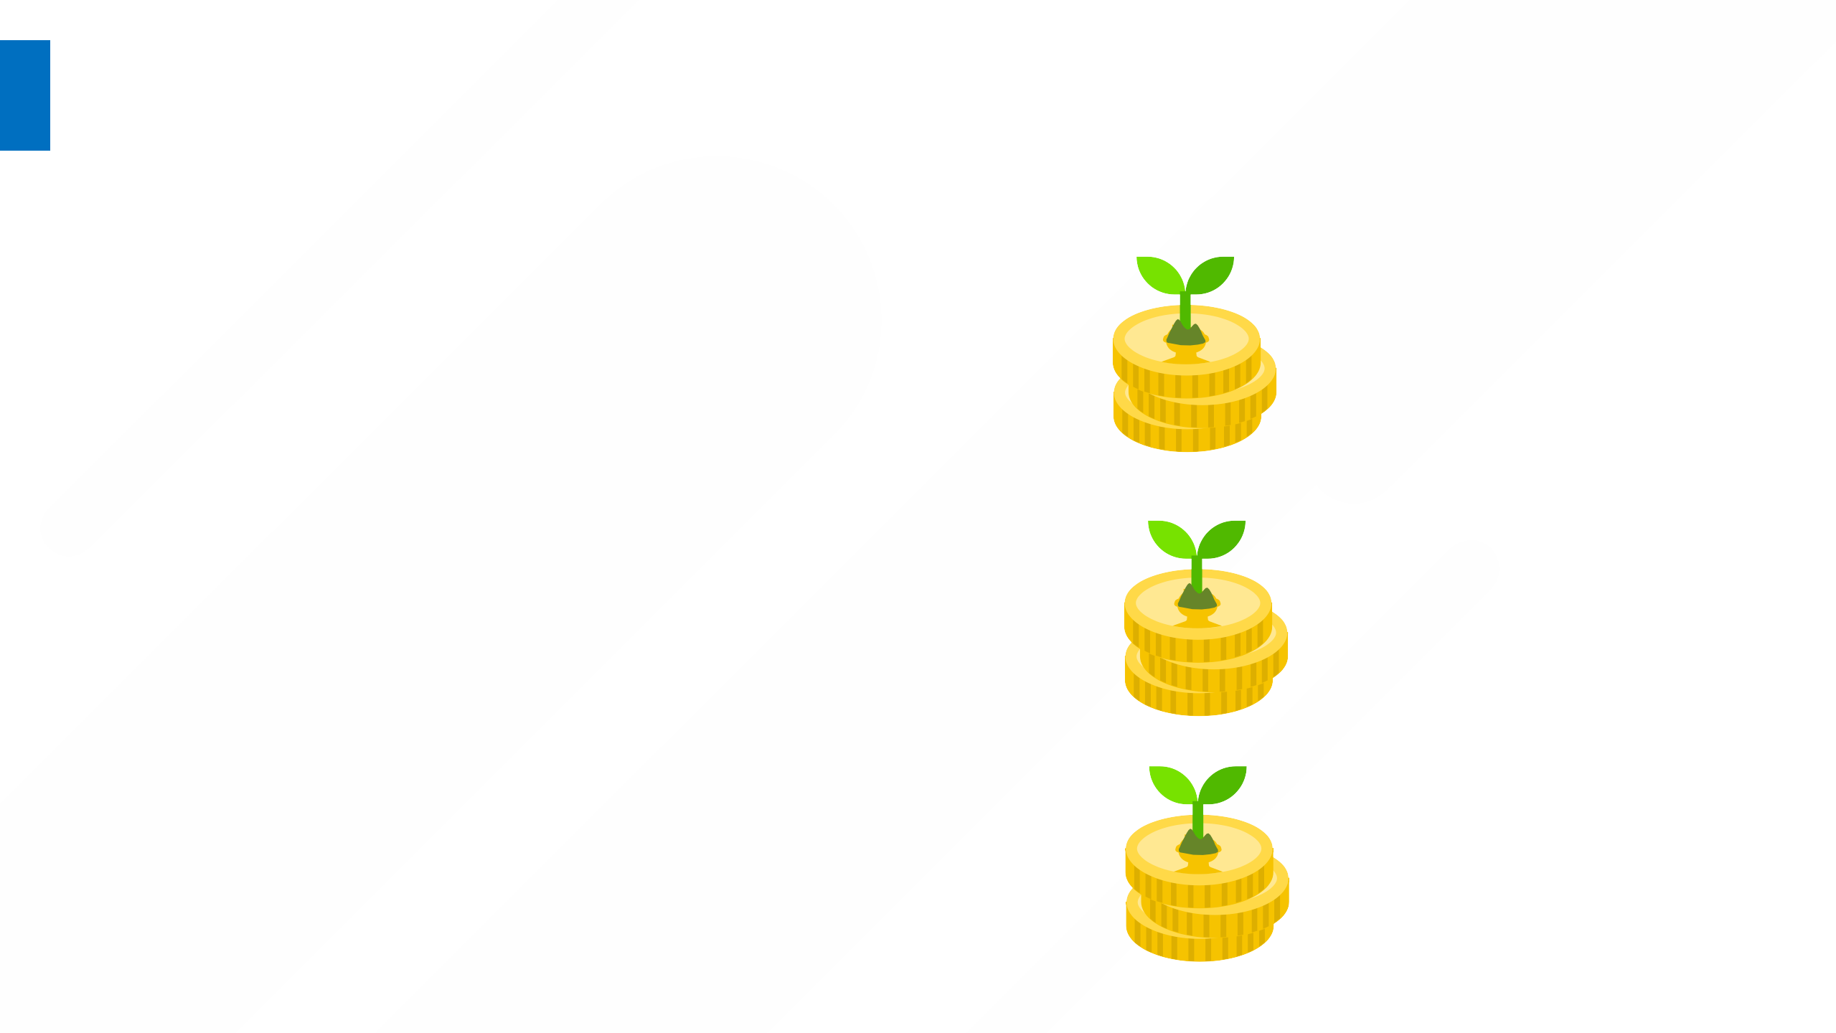
Value Proposition
The Value Proposition is the reason why customers turn to one company over another. The Value propositions is typically the benefits that a company offers to their customers
Gains :
Good Quality
Low Cost
Unique Design
Quantitative
Speed of service
Pricing innovations and competition
Qualitative
Improve the customer experience
Improved emotional strategies
Enhancing status
Personalization
Radical & Game -Changing
Disrupt an industry through new product, service, or industry
4
Pains :
Branded t-shirt at low cost.
Never disappoint.
Remove Financial Problem.

Slide 5
Customer Relationships
The relationship that each Customer Segment expect us to establish and maintain with them?
The drivers to establish the relationship:
Acquire customers
Retain customers
Increase sales (upselling & cross selling)
To make better relationship with customer we need :
Better Communication
Responsiveness
Great Quality
Transactional
One time
E.g. Airports, Kiosks
Long Term
Deep relationship
E.g. Banks
Think about open source tools, the main customer relationship through community knowledge, while for mobile operators through Personal assistance and self-services
5

Slide 6
Customer Segments
The different groups of people you aim to reach and serve. It is the heart of the business model
Customers are grouped into segments based on common needs, problems, or behaviors.
Mass Market
large group with broadly similar needs
E.g. All population
Niche Market
A specific group with very specific needs.
E.g. Bloggers
Segmented
Groups with slightly different needs.
E.g. Technology Bloggers,
Health bloggers
Steps:
Geographic Segmentation ( Karachi unmost Popular areas )
Demographic Segmentation ( Boys and Men’s , 14-40 )
Psychographic Segmentation ( Middle Class )
6

Slide 7
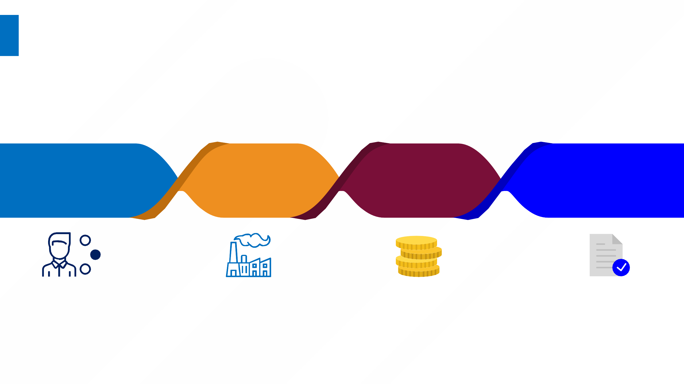
Key Resources
Key Resources to deliver the Value Proposition to the Customer Segments
What are the resources required to create, deliver, maintain, and improve the value? The resources helps in creating the relationships, reaching the customers.
Intellectual Property
Human
Physical Financial
Manpower of humans that creates the industry and knowledge
Machine technology that produce our product is the one of our key resources
Good Saving in economy
Patents and copyrights, partnerships, and customer databases
7

Slide 8

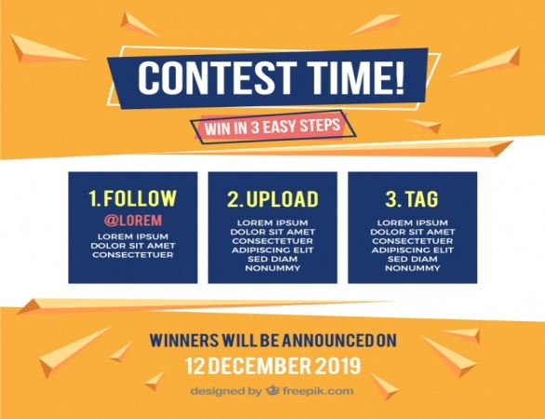
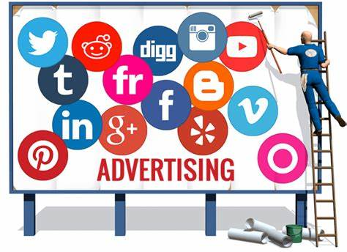
Channels
How will we communicate with and reach the customers to deliver our value
Channels serve as touch points that determine the customer’s acknowledgment and satisfaction.
E-Commerce Website
Social Media Contest
Social Media Ads
We establish channels for sales, marketing, communications, getting feedback, deliver value, support, …etc.
8

Slide 9
Cost Structure
All costs incurred to operate your business model
Value-Driven
Focus on value creation regardless the cost
implications
Cost-Driven
Minimizing costs wherever
possible
It includes cost of:
Resources
Equipment
Facilities
Activities
Platforms
Production Cost
Its include the cost of production of
t-shirt
Fixed cost
Equipment and facilities to customers
E.g. Fabric, facilities
Variable cost
Web store Cost
E.g. Website, Software Development
Advertising cost
Cost for advertising our product.
E.g. Social Media ads and campaign.
9

Slide 10
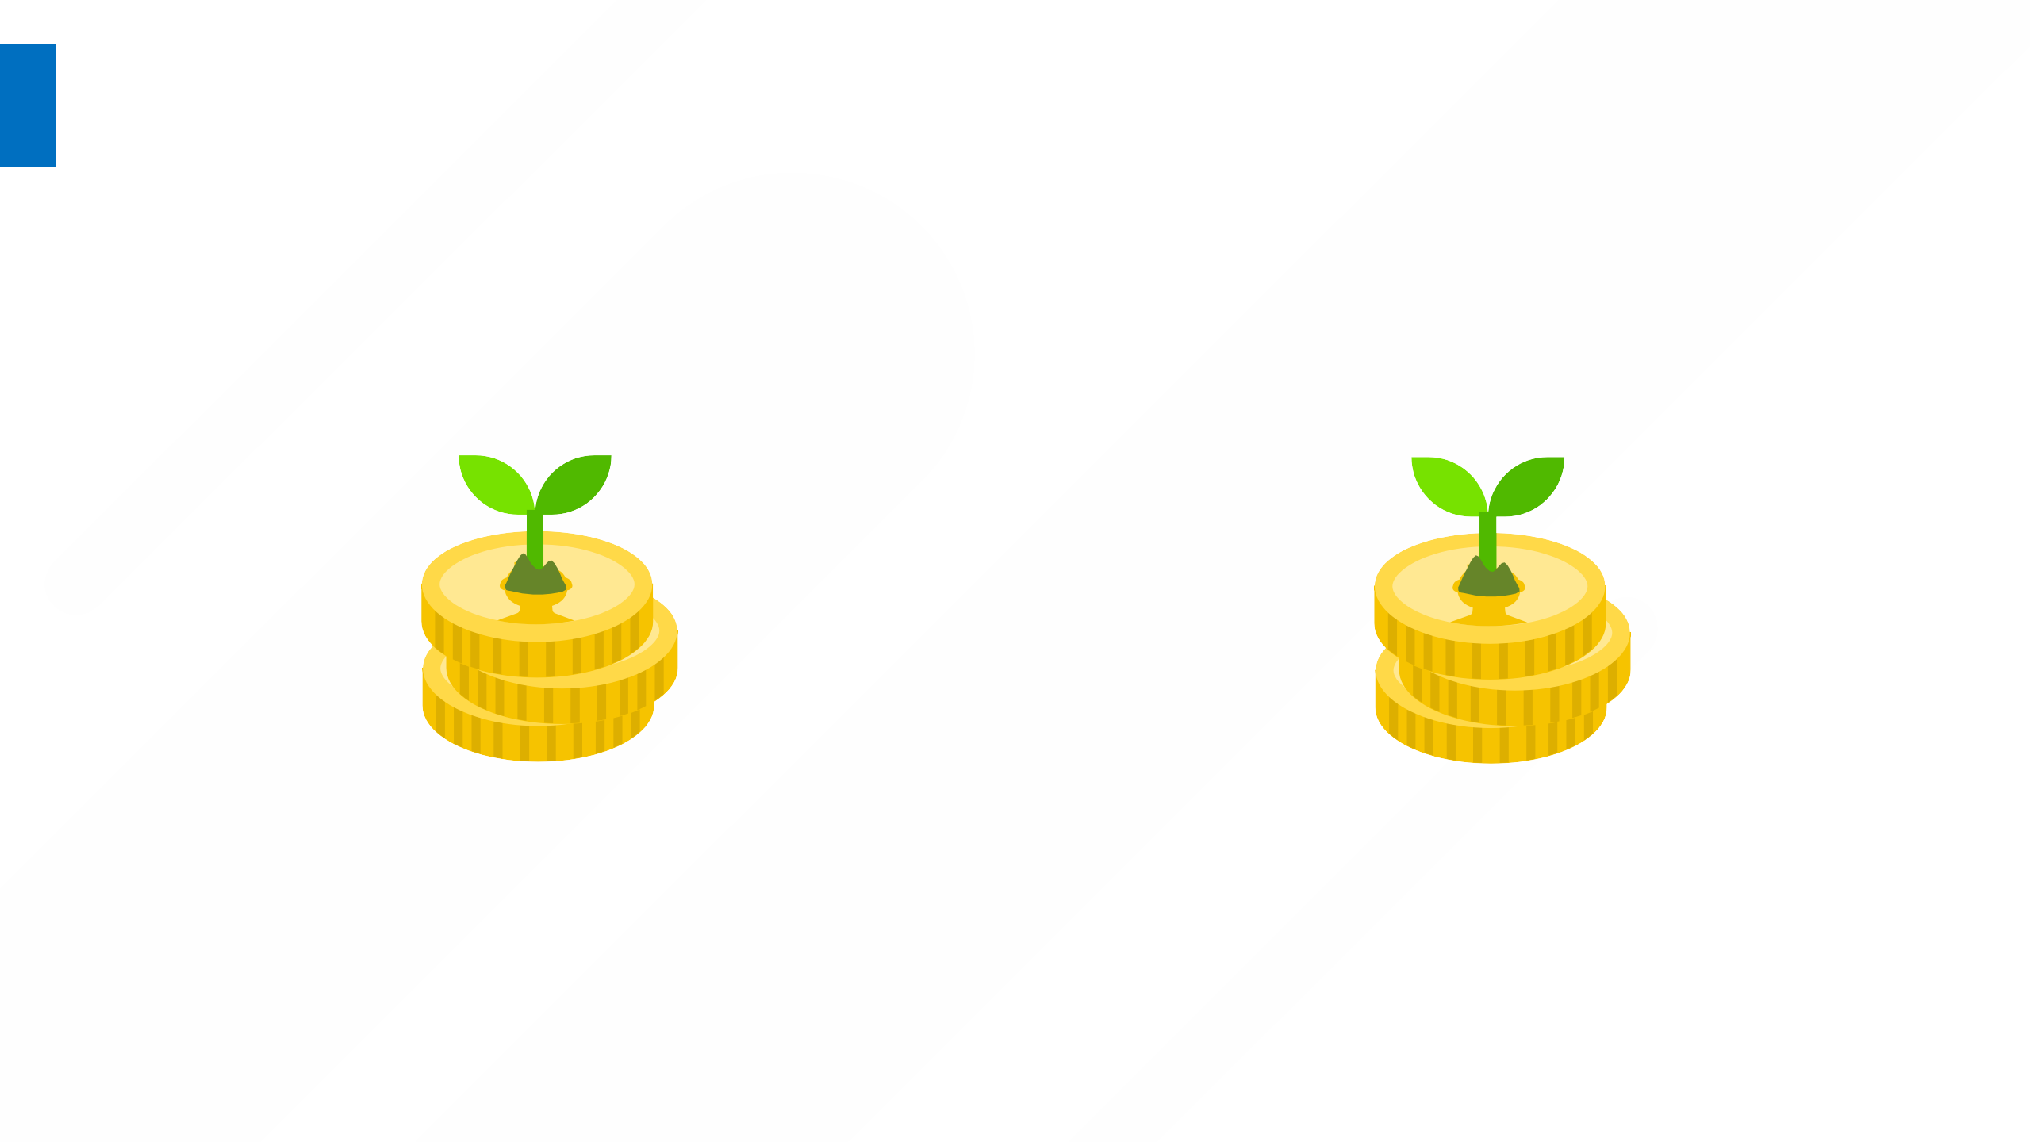
Revenue Streams
Customer Segments is the heart of a business model, the Revenue Streams are its arteries
How we get money as revenue to sustain our business?
Each Revenue Stream has a pricing mechanism such as fixed list pricing, discount pricing, market dependent pricing, or volume dependent pricing
Transactional
one-time customer payment
E.g. Buy book, computer, or phone
Recurring
Ongoing payments
E.g. Subscription, Usage, renting, Licenses
10

Slide 11
THANK YOU.
M.HASSAN SOHAIL (10035)
MUHAMMAD USAMA (9642)
MUHAMMAD BILAL HADID (9867)
11

